Slide 1
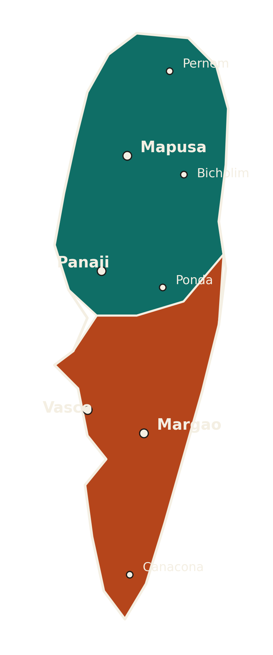
A GOA E-WASTE TRACKER BRIEFING
Goa's E-Waste Reckoning
A district-level scorecard of generation, collection, recycling and compliance across North and South Goa
North Goa
South Goa
Compiled from the Goa E-Waste Tracker (GSPCB / CPCB, E-Waste Management Rules 2022) · Fiscal Year 2025-26 · Data current to 31 March 2026

Slide 2
GENERATION & INVENTORY
The Scale of the Problem
State-wide e-waste generation, by district and category
1,677.3 t
940.7 t
736.6 t
1.15 kg
TOTAL STATE GENERATION / YR
NORTH GOA (56.1%)
SOUTH GOA (43.9%)
PER-CAPITA GENERATION / YR
Category-Wise Breakup by District (kg)
District Snapshot
North Goa
Population 818,008 · 940.7 t generated
Largest category: IT & Telecom (301.0 t)
South Goa
Population 640,537 · 736.6 t generated
Largest category: IT & Telecom (235.7 t)
Read: IT & telecom and consumer electronics together account for over 46% of all e-waste generated statewide, consistent with rapid device replacement cycles.
GOA E-WASTE TRACKER · GSPCB / CPCB E-Waste (Management) Rules, 2022 · Data as of 31-03-2026
2

Slide 3
COLLECTION PERFORMANCE
The Collection Gap
How much of what's generated is actually being collected
67.8%
78.5%
STATE COLLECTION RATE
EPR TARGET ACHIEVEMENT
32
21.9
REGISTERED COLLECTION CENTERS
CENTERS PER MILLION POPULATION
Read: North Goa collects a larger share of its own generation (70.0%) than South Goa (65.0%), despite South Goa having fewer centers per capita. Statewide EPR collection targets (1,845 t) are running behind actual generation, a gap of roughly 21.5%.
GOA E-WASTE TRACKER · GSPCB / CPCB E-Waste (Management) Rules, 2022 · Data as of 31-03-2026
3

Slide 4
FORMAL RECYCLING & TREATMENT
The Recycling Paradox
Authorized processors are handling more waste than the state generates this year
3,300 t
2,158 t
65.4%
72.5%
INSTALLED ANNUAL CAPACITY
QUANTITY PROCESSED THIS YEAR
CAPACITY UTILIZATION
WEIGHTED MATERIAL RECOVERY
Authorized Recyclers & Dismantlers
Reading the Paradox
Recycler / Dismantler | District | Capacity (t/yr) | Processed (t) | Recovery Rate
Global E-Waste Mgmt. System (GEMS) | North Goa | 100 | 78 | 76%
V Recycling Industries - Sao Jose | South Goa | 1,500 | 980 | 74%
V Recycling Industries - Fatorda | South Goa | 1,200 | 790 | 72%
Group TenPlus | Statewide | 500 | 310 | 68%
Recyclers processed 2,158 t this year against 1,677.3 t of newly generated waste — 128.6% of current-year generation. This points to legacy stockpiles and informally-sourced material finally entering the formal chain — encouraging, but it also means official 'processed' figures overstate how much of this year's waste is actually captured.
GOA E-WASTE TRACKER · GSPCB / CPCB E-Waste (Management) Rules, 2022 · Data as of 31-03-2026
4

Slide 5
REGULATORY COMPLIANCE
Producers & EPR Compliance
8 registered EPR entities operating under GSPCB oversight
87.5%
75.0%
2
INSPECTIONS CONDUCTED
FULLY COMPLIANT ENTITIES
PENALTIES
UNRESOLVED
Flagged Cases
Entity | Status | Inspected | Penalty Issued | Resolved
EPR/2024/GA/004 | Partially Compliant | Yes | Yes | No
EPR/2024/GA/005 | Compliant (self-reported) | No | No | N/A
EPR/2024/GA/007 | Non-Compliant | Yes | Yes | No
Read: Both show-cause cases (entities 004 and 007) remain unresolved, and one 'compliant' entity (005) has not yet been inspected — its status is self-reported only.
GOA E-WASTE TRACKER · GSPCB / CPCB E-Waste (Management) Rules, 2022 · Data as of 31-03-2026
5

Slide 6
INFORMAL SECTOR INTEGRATION
Three Hotspots, One Blind Spot
Informal recycling clusters remain only partially brought into the formal system
3
60
20 (33%)
0 of 3
KNOWN INFORMAL HOTSPOTS
ESTIMATED INFORMAL WORKERS
WORKERS REGISTERED / TRAINED
HOTSPOTS FULLY FORMALIZED
NORTH GOA
SOUTH GOA
SOUTH GOA
Mapusa Market Belt
Margao Market Belt
Vasco Industrial Belt
Partially Formalized
Partially Formalized
Not Formalized
Workers: 25 est. / 10 trained
Action taken: Awareness + registration drive by GSPCB/GEMS
Workers: 20 est. / 8 trained
Action taken: Linked to V Recycling Industries as collection point
Workers: 15 est. / 2 trained
Action taken: Initial survey only — formalization pending
GOA E-WASTE TRACKER · GSPCB / CPCB E-Waste (Management) Rules, 2022 · Data as of 31-03-2026
6

Slide 7
ENVIRONMENTAL & HEALTH SAFEGUARDS
What the Monitoring Found
Soil, water and health surveillance at the state's informal hotspots
3 of 3
2 of 3
110
1 Exceedance
HOTSPOTS MONITORED
HEALTH CAMPS CONDUCTED
BENEFICIARIES SCREENED
LEAD (PB) — MARGAO
Site | District | Monitoring | Date | Result | Health Camp | Screened
Mapusa Market Belt | North Goa | Soil | 10-05-2026 | Within Limit | Yes | 60
Margao Market Belt | South Goa | Soil + Water | 15-05-2026 | Exceeds Limit (Pb) | Yes | 50
Vasco Industrial Belt | South Goa | Water | 20-05-2026 | Within Limit | No — scheduled next quarter | 0
Read: The Margao cluster is the only site with a confirmed contamination exceedance (lead), and a remediation plan has been submitted to GSPCB. Vasco has had no health camp yet despite being the least-formalized hotspot — a monitoring and outreach gap worth prioritizing.
GOA E-WASTE TRACKER · GSPCB / CPCB E-Waste (Management) Rules, 2022 · Data as of 31-03-2026
7

Slide 8
AWARENESS & OUTREACH
Reaching the Public
Campaigns, buy-back drives and community outreach conducted this year
5
3,270
3
1,800
PROGRAMS CONDUCTED
TOTAL PARTICIPANTS REACHED
SCHOOL / RWA DRIVES
LARGEST SINGLE DRIVE (STATEWIDE)
Program | District | Date | Type | Reached
Statewide E-Waste Collection Drive (GSPCB-GWMC) | Statewide | 15-07-2025 | Buyback / Collection | 1,800
E-Waste Awareness Drive - Schools | North Goa | 18-04-2026 | School Collection Drive | 450
Margao Municipal Council Collection Drive | South Goa | 22-04-2026 | RWA / Community Drive | 300
Goa University Campus E-Waste Collection | North Goa | 05-05-2026 | School Collection Drive | 220
Panaji Municipal Awareness Session | North Goa | 20-05-2026 | Public Awareness Campaign | 500
Read: North Goa hosts 4 of 5 programs and the majority of reach outside the single statewide drive — South Goa's outreach (one RWA drive, 300 people) is comparatively thin relative to its e-waste generation share.
GOA E-WASTE TRACKER · GSPCB / CPCB E-Waste (Management) Rules, 2022 · Data as of 31-03-2026
8

Slide 9
SYNTHESIS
Strengths & Gaps
Where Goa's e-waste system is working, and where it isn't
WHAT'S WORKING
WHERE THE GAPS ARE
• 78.5% EPR collection-target achievement in both districts — consistent, not lopsided
• Formal recyclers processed more material than was newly generated (2,158 t vs. 1,677 t) — legacy backlog is being drawn down
• 75% of registered EPR entities are fully compliant, with 87.5% inspection coverage
• All 3 known informal hotspots are at least partially engaged — none are being ignored
• Only 33% of estimated informal-sector workers (20 of 60) are registered or trained
• Zero hotspots are fully formalized — Vasco remains at survey stage only
• Two EPR show-cause penalties remain unresolved; one 'compliant' entity has never been inspected
• Confirmed lead (Pb) exceedance at Margao; Vasco has had no health camp at all
GOA E-WASTE TRACKER · GSPCB / CPCB E-Waste (Management) Rules, 2022 · Data as of 31-03-2026
9

Slide 10
THE PATH FORWARD
Five Priorities for Next Quarter
Targeted actions to close the gaps identified in this tracker
01
02
03
04
05
Remediate Margao
Stand up Vasco's health camp
Resolve the two open penalties
Inspect the unverified 'compliant' entity
Expand South Goa outreach
Act on the submitted Pb remediation plan and re-test soil/water within one quarter.
The least-formalized hotspot has had zero health screening — schedule immediately, don't wait for next quarter.
Show-cause cases against entities 004 and 007 should be closed out, not left pending indefinitely.
Entity 005 is self-reported only — schedule the inspection that's already marked as planned.
South Goa generates 44% of state e-waste but received only one dedicated awareness program this year.
GOA E-WASTE TRACKER · GSPCB / CPCB E-Waste (Management) Rules, 2022 · Data as of 31-03-2026
10

Slide 11
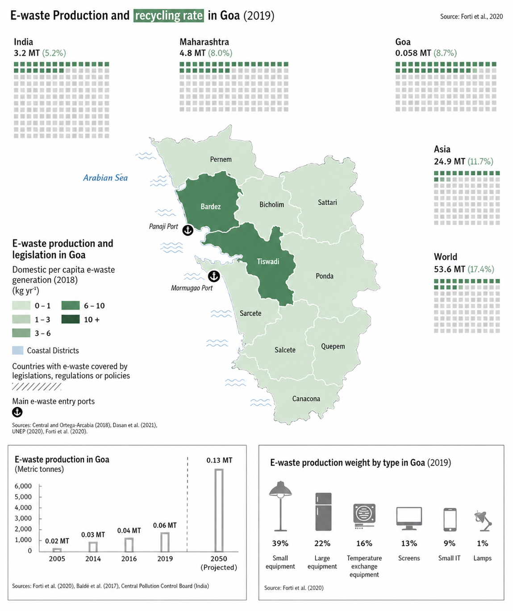
APPENDIX
District-Level Reference Map
External research context, shown for comparison — not part of the GSPCB tracker dataset
Source: Forti et al., 2020 (Global E-waste Monitor) — reproduced as uploaded, for reference only.
GOA E-WASTE TRACKER · GSPCB / CPCB E-Waste (Management) Rules, 2022 · Data as of 31-03-2026
11

Slide 12
Sources & Methodology
Data: Goa E-Waste Tracker — a 7-sheet operational dataset covering generation, collection, formal recycling, EPR compliance, informal-sector hotspots, environmental/health monitoring and awareness programs, structured around the E-Waste (Management) Rules, 2022 (CPCB, India) as implemented by the Goa State Pollution Control Board (GSPCB).
Population: Census 2011 district totals (North Goa 818,008 · South Goa 640,537); to be refreshed once Census 2027 / GSPCB projections are published.
Coverage window: FY 2025–26, data current to 31 March 2026. Recommended refresh cycle: quarterly or annual, tracked against the tracker's built-in scorecard.
Note: The tracker's benchmark values on the scorecard sheet are placeholders pending state-specific targets; scores in this deck are drawn directly from the underlying data sheets rather than the unset scorecard formulas. The district reference map (previous page) is an external source, included for comparison only.
GOA E-WASTE TRACKER · GSPCB / CPCB E-Waste (Management) Rules, 2022 · Data as of 31-03-2026
12

